Slide 1
Vertical Temperature Patterns

Slide 2
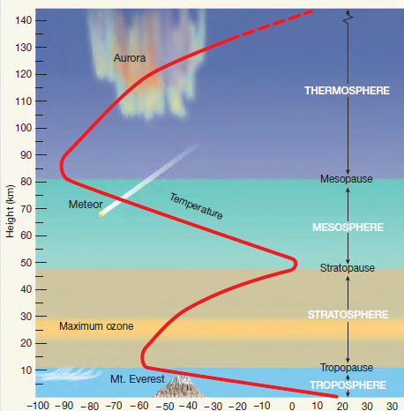
Vertical Change
Since temperature and heat drive atmospheric processes, the vertical change in temperature with height is used to define coastal areas generally have smaller temperature variations than inland areas layers.

Slide 3
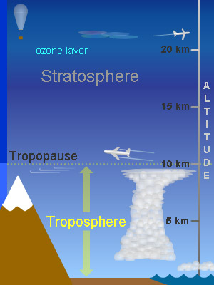
Tropopause
The tropopause is the layer closest to the surface, and it distinguished by a decrease in temperature with height.
Since most solar radiation is absorbed by the Earth’s surface, temperature will be highest closest to the surface and decrease from there.
Vertical heat (sensible and latent) and radiation fluxes work to transport energy upwards to disperse the excess energy into the atmosphere.

Slide 4
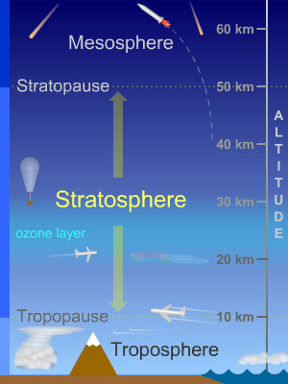
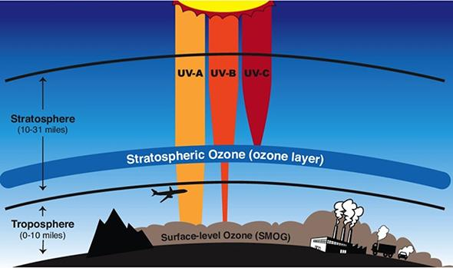
Stratosphere
The stratosphere is characterized by an increase in temperature with height, primarily due to the absorption of solar radiation by the ozone layer.

Slide 5
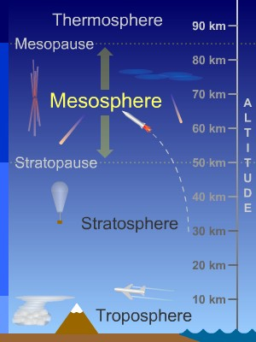
Mesosphere and Thermosphere
The mesosphere and thermosphere are the other two atmospheric layers based on temperature, with temperature decreasing with height through the mesosphere and increasing in the thermosphere.
Keep in mind that heat is related to both temperature and density of air, so although temperatures are the highest in the thermosphere it is not warm there!

Slide 6
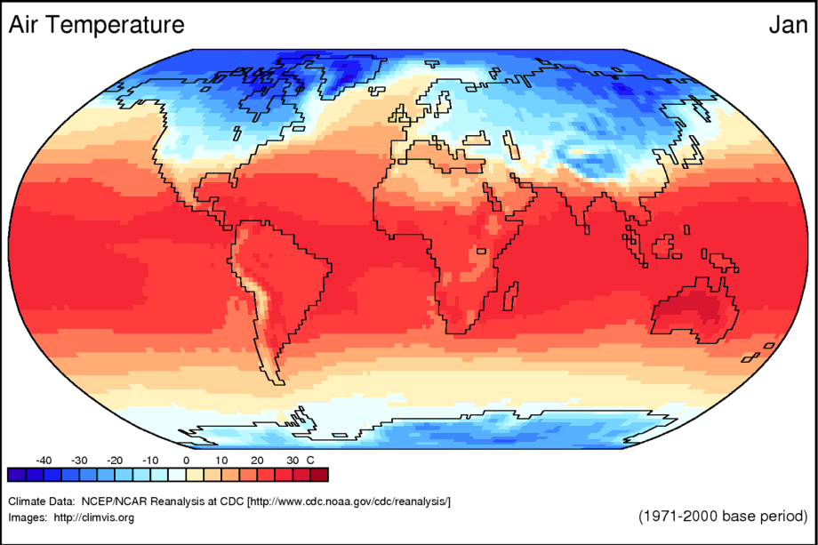
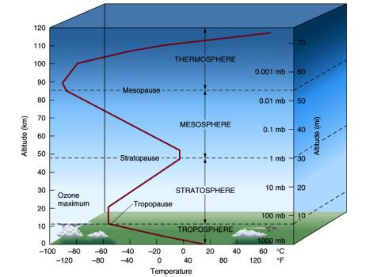
Vertical vs. Horizontal
As you go up in the atmosphere, there is less of an influence of local-scale surface factors on temperature gradients.
Horizontal temperature patterns become more related to the global energy balance, with a general north-south temperature gradient between the Tropics and Arctic.

